Slide 1
English Activity Day
For intermediate Section
2015

Slide 3
Intermediate section
( grade 7th , 8th , 9th ),
108 students participated in the
English activity day .
The girls were very good & enthusiastic for this , thus achieving the goal of
this a activity Day.

Slide 7
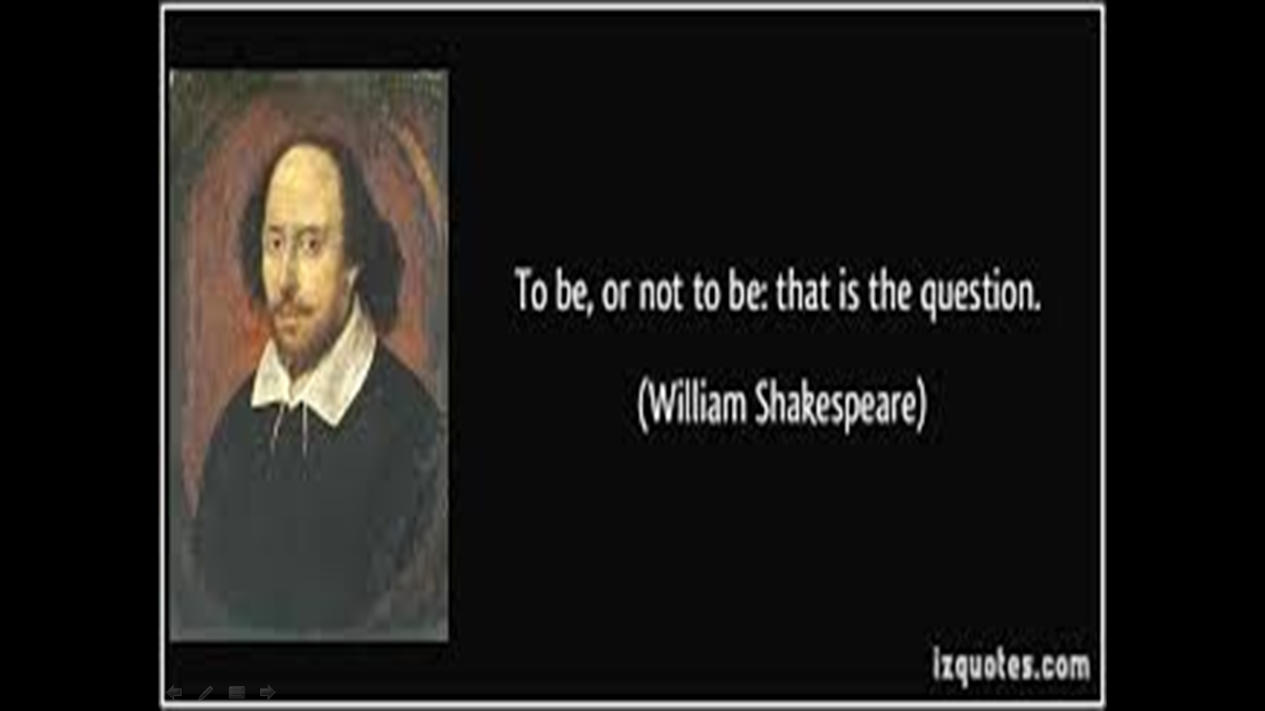

Slide 9
Thank you

